Slide 1
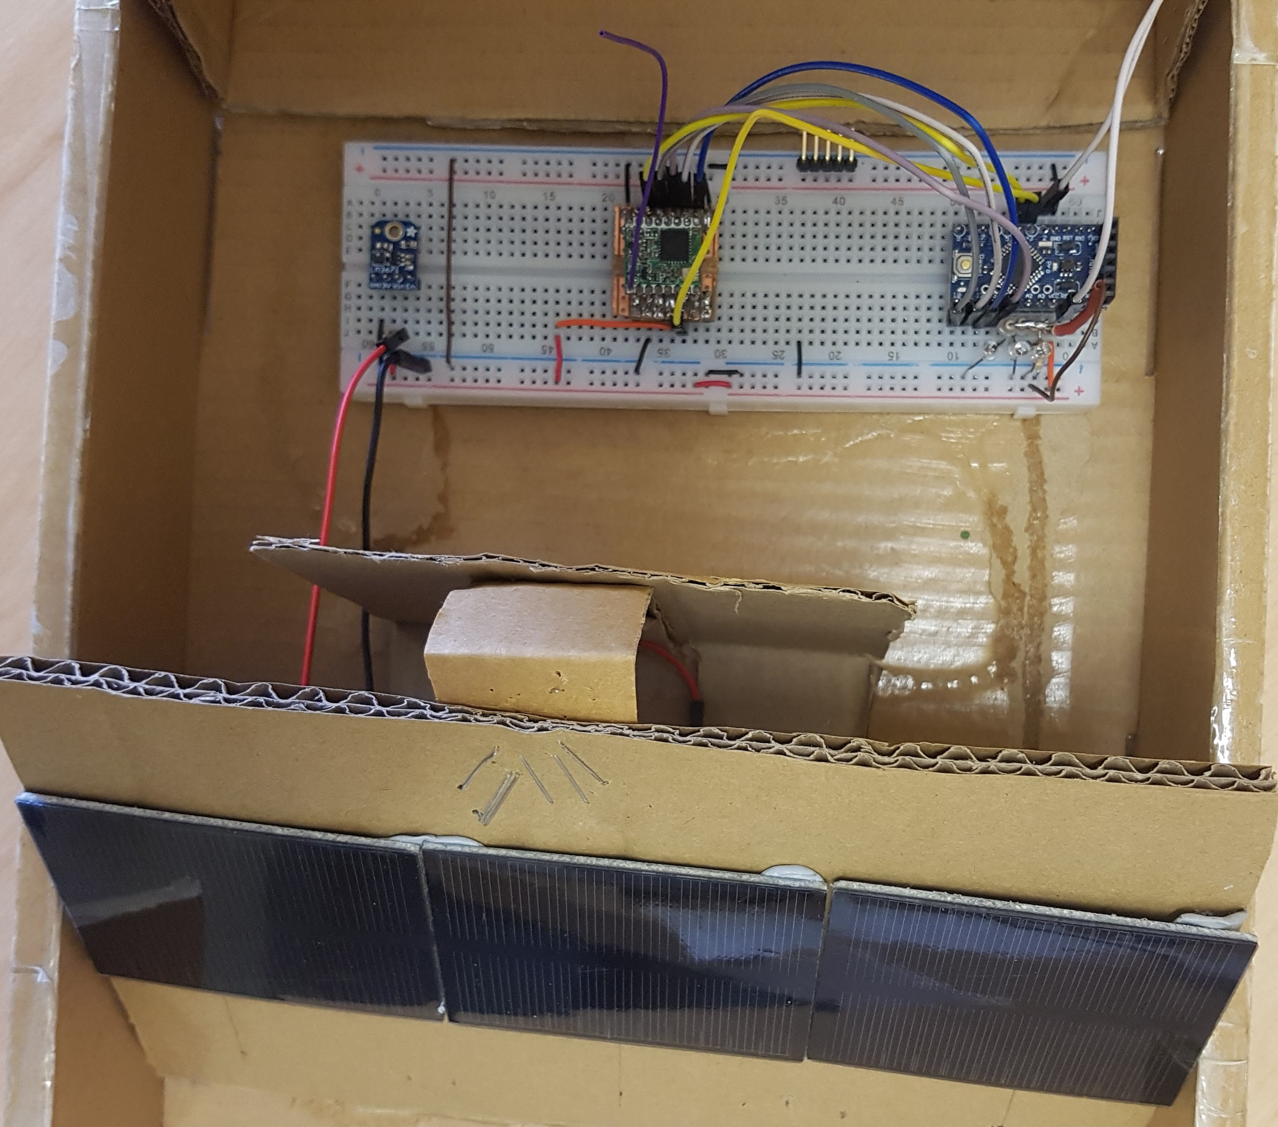
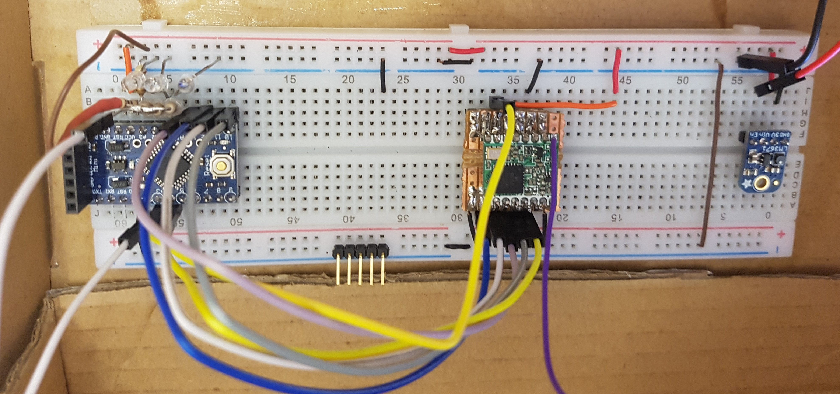
Design of a small satellite UHF Identification and TT&C radio Beacon
PLTOFF Travis McKee, Supervisors – Dr Edwin Peters & Dr Craig Benson
AIM:
To provide a design and ground tested prototype for a self contained UHF radio beacon for small satellite applications that provides an identification tag, basic telemetry data and an RF signal that can be tracked by geographically dispersed ground stations. This system will provide a TT&C data link to a satellite independent of any failures in the satellite primary systems.
VALUE:
The capability to identify an individual satellite during a multiple satellite launch from a single vehicle, provide on-orbit fault-finding and rectification to reduce satellite failure rates and provide ground station tracking for space monitoring organisations to increase low earth orbit (LEO) space situational awareness.
COMPLETED:
Theoretical system design based on a generic LEO satellite mission showing proof of concept. A successful bread-board based prototype has been constructed using an Arduino based microprocessor and RFM95 LoRa radio module, powered by 3 monocrystalline silicon solar panels regulated by a 3.3V Buck converter capable of transferring data over a short distance.
Future Work
Develop an efficient power generation, storage and regulation system for an integrated PCB design
Completion of PCB Prototype construction and all ground testing
Extension
Develop a full single frequency identification system
Integrate satellite control with in-built cyber security
Intergrade a full receive capability
Full tested system ready for space operations
Design and develop the ground monitoring system
Develop a publicly contributed monitoring concept

